Slide 1

LET’S LEARN
FULL-STACK WEB DEVELOPMENT
Step by Step Guide and Roadmap

Slide 2
Meeting
Reminders
Please mute your microphone unless asked a question.
Turn off your cameras.
While waiting for others to come in, here are some rules and reminders to keep in mind.
Questions sent via the chatroom
will be answered after each workshop segment.

Slide 3
Our agenda this meeting
Meeting Structure
Who is Full Stack Developer?
Programming Languages
and Frameworks
Additional Tools and Software
Project Discussion
Duration of this Journey & Roadmap
How To Monetize this Skill
The Bottomline

Slide 4
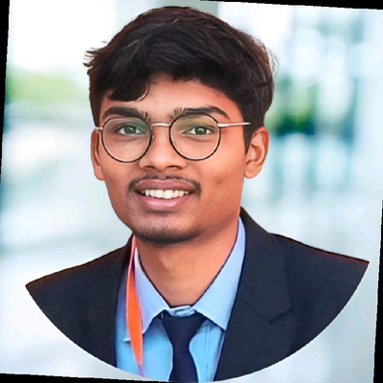
About Me
My Start Ups
Jobs & Internships
Hi, my name is
Kuldeep Kaware
I build things for the web.
Balaghatbookshop.com
DigitalSankul.com
BigitalWeb.com
ConnectShiksha.tech
PortfolioBazar.live
E-intellisense.com
ReadyMotive.in
Softseekersinfotech.com
Toneops.com
Auxost.com
Partnership
Freelancing
I am a Freelance Full Stack Web Developer. I work with Influencers, start-ups, and individuals who want to get more online visibility from more than 3+ years.
AnanataPower.com
Ghostlinelegal.com
Digital Marketers
Other Freelancers
Fiverr.com
Freelancer.com
Linkedin.com
Kuldeepkaware.com

Slide 5
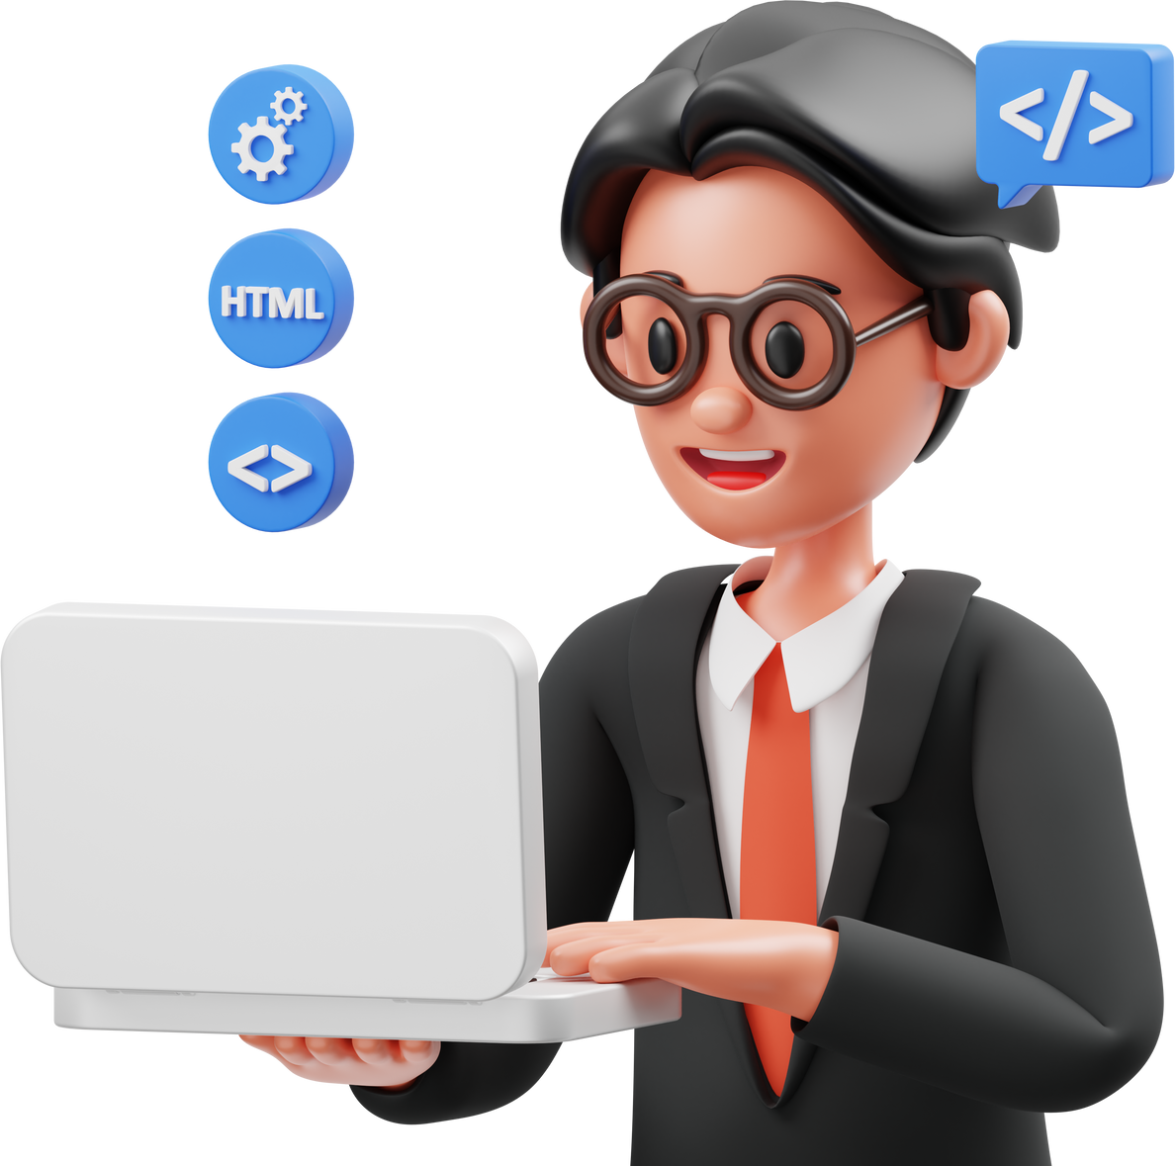
Who is
Full Stack
Web developer ?
What must you know to become a Full stack developer.
Front-end
Back-end
Database

Slide 6
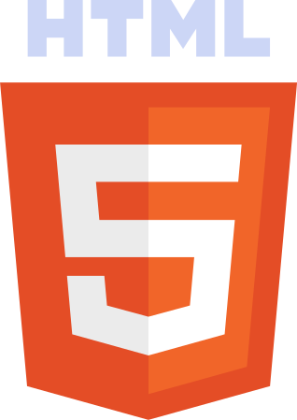
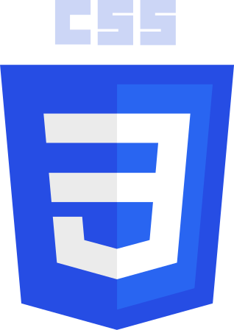
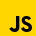


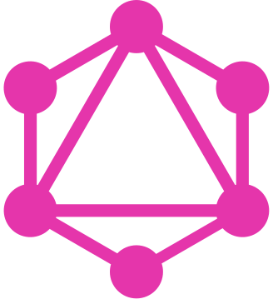
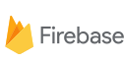


Front-end
Programming Languages
and
Frameworks
Back-end
Database and Storage

Slide 7




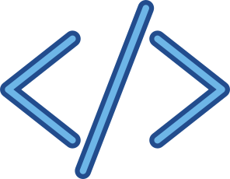
Version Control and IDE
Additional Tools
and Software
Deployment tools
Vs code & Chrome Extensions

Slide 8


From Our Side
What Next ...
Portfolio Website
Landing Page
Ecommerce Webapp
ChatGPT Clone
Instagram Clone
Practice Practice Practice
10+
Projects
From Your Side
Front End Project 1
Front End Project 2
Full Stack Project 3
Full Stack Project 4
Your Start Up Website
Project Project Project

Slide 9

Duration of this Journey & Roadmap
Back end Development
Advance JavaScript
React Js
Node js
Database and AWS
Full Stack Project
Duration - 1.5 month
Front end Development
Projects Development
Front-End for Beginners
Advance CSS & Framework
JavaScript Basic
Project one
Project two
ChatGPT Clone
Instagram Clone
Duration - 15 Days
Practice Practice Practice
Duration - 1 month

Slide 10
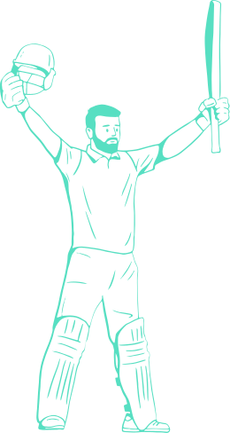
YOU HAVE DONE ...
75%
NOW WHAT ABOUT REST 25% ...

Slide 11
How To Monetize this Skill
Internships
Jobs
Freelancing
Internshala.com
LinkedIn.com
Hellointern.com
Noukri.com
LinkedIn.com
Indeed.com
Fiverr.com
LinkedIn.com
Freelancer.com
Duration - 3 to 6 months
Duration - 1 to 2 Years
Duration - 3 months try

Slide 12
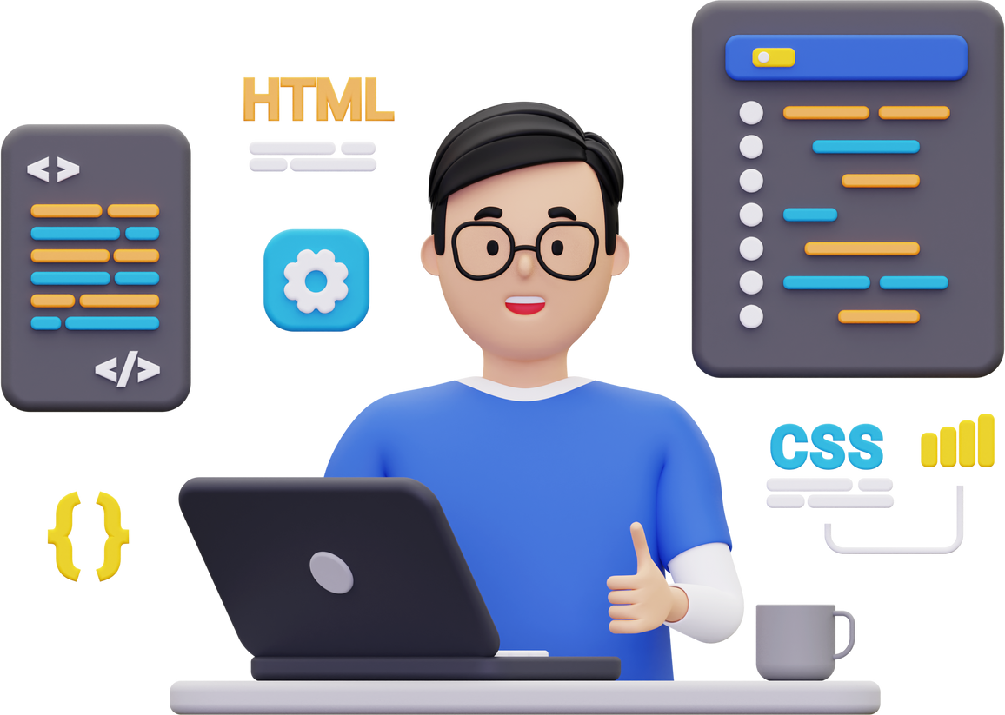
Your Start Up
Solve the Real
world Problems
with
Your Skills

Slide 13
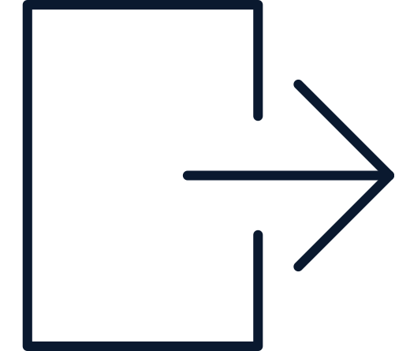




The Bottomline
Learning a Language or Skill
Build Projects and Practice
Internship or Freelancing Work
Get Experience and apply for JOB
Life set ....

Slide 14
Thank you for listening!
Feel free to send in any questions
to me on WhatsApp 9131782103.

Slide 15
Certificate of Participation

Slide 16

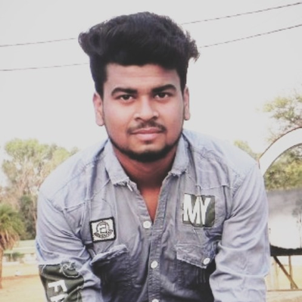
Upcoming Sessions
Rohit Kewat
Rohit Bisen
Full Stack Instructor
Campus Ambassador

